Slide 1
STEM Fair Graphs

Slide 2
Data Tables
Make sure your data tables include:
A title
Appropriate labels and SI units for both the dependent and independent variables
Averages of data
Your graphs should be a representation of the averages of your data! Not all the data that you collect!

Slide 3
What type of graph should I use to analyze my data?

Slide 4
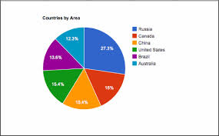
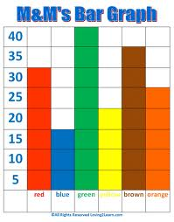
Types of graphs
Pie Chart
Used to compare parts to a whole (percentages)
Bar Graph
compare values in a category or between categories. Multiple bar graphs compare relationships of closely related data sets. These graphs may be used to demonstrate relationships in non-continuous data or data intervals.
Typically NOT USED for STEM projects

Slide 5
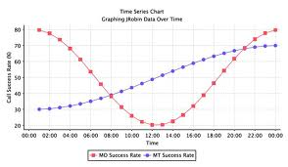
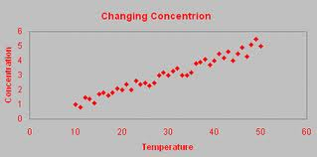
Types of Graphs Continued
Time-Series Plot
dependent variable is numerical and the independent variable is time
XY Line Graph
dependent and independent variables when both are numerical and the dependent variable is a function of the independent variable
Scatter plot
Shows how two variables MAY be related to one another

Slide 6
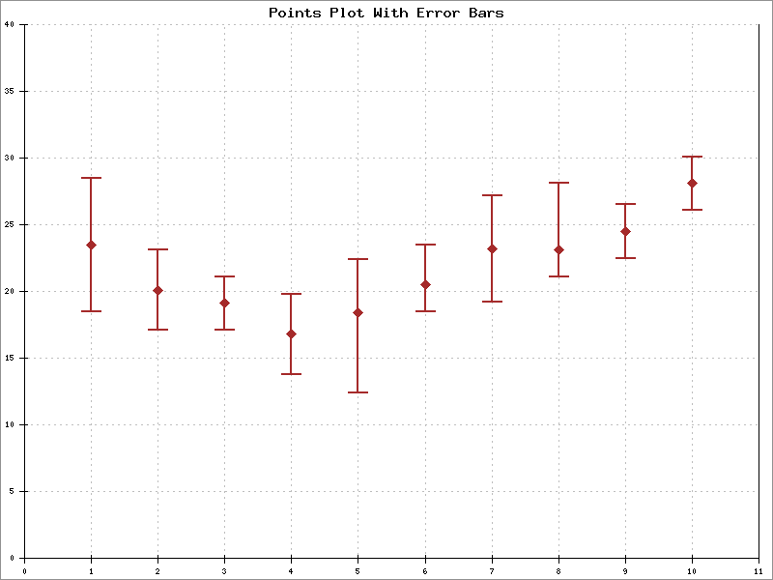
Why do I need error bars on my graph?

Slide 7
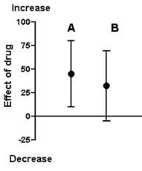
Error bars
Show variability in data
Indicate error and/or uncertainty
in measurement
A larger size error bar means the measurement/ data collected is not as accurate
Error bars should be one standard deviation in length

Slide 8
What is the standard deviation?

Slide 9
Standard Deviation
The most common means of measuring the amount of variation from the mean that exists for each experimental group.
A low standard deviation indicates that the data points tend to be very close to the mean
A high standard deviation indicates that the data points are spread out over a large range of values.

Slide 10
What is the coefficient of correlation (r)?

Slide 11
Coefficient of Correlation (r)
used to fit a straight line (best-fit) to sample data to summarize the relationship between x and y values.
Sample correlation coefficient (r) is calculated to measure the extent to which x and y are linearly related.
Example would be looking at the relationship between % salinity in water (x) and nitrate level (y).
Example of results would be that a simple linear regression model explained 91.3% of total variation in nitrate level by relating it to salinity

Slide 12
Coefficient of Correlation (r)
Only use if graph is a line graph or scatterplot (not for time series)
Describes the direction and strength of 2 sets of variables
Calculate when the line of best fit is made on a graph in excel
R Values
Positive Correlation = Direct relationship for data
Negative correlation = Indirect relationship for data
r = 0, no correlation
r < 0.5, weak correlation
r > 0.8, strong correlation
r = 1 perfect correlation

Slide 13
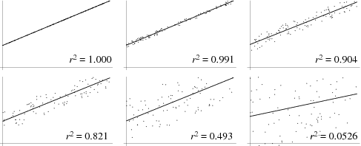
Coefficient of Correlation examples

