Slide 1
Drill
Name an example of mollusk you know of.

Slide 2
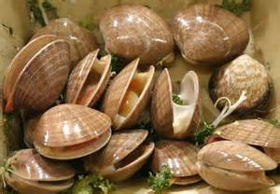
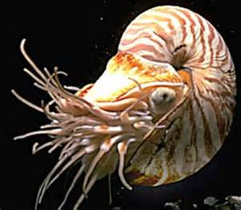
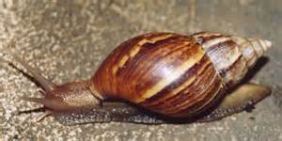
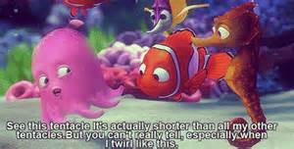
Mollusks

Slide 3
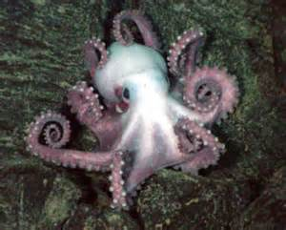
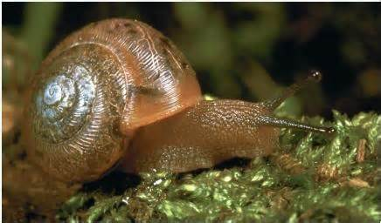
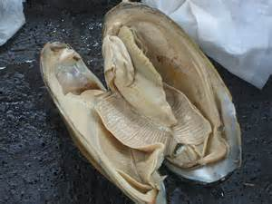
Characteristics
Some are filter feeders
Some are fast moving predators
Muscles separate from gut so the food can move easily through the gut
Circulatory system can transport blood without interference from other organs

Slide 4
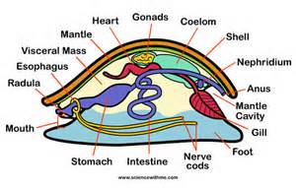
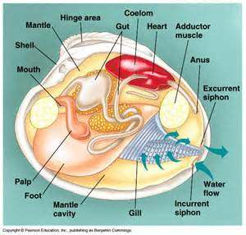
Body Plan
Head- mouth and sensory structure
Foot-large muscular organ for locomotion
Visceral Mass- Above head-foot, contains heart and organs of digestion, excretion, and reproduction.
Mantel- cover of visceral mass with layer of epidermis.
Mantel Cavity- space between mantel and visceral mass.
Ganglia- Paired cluster of nerve cells.
Radula- Main feeding adaptation.
Siphon- Tube like structure in which water
enters and leaves the body.

Slide 5
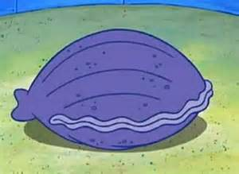
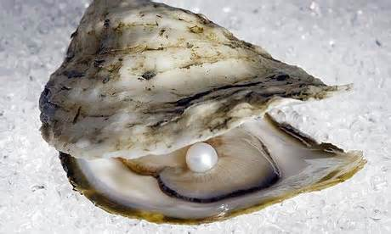
Class Bivalvia
Shells that are divided into two halves, or valves, that connect by a hinge.
Bivalve can close its shell by contracting the adductor muscles- muscle with which bivalve close its shell- and relaxes to open.
Each valve consists of three layers-
1.) Thin outer layer- protects from acidic conditions in H2O.
2.)Thick middle layer-made up of calcium carbonate-strengthens shell.
3.)Inner layer- smooth and iridescent- protects animal’s soft body.
Aquatic mollusks, filter feeders, only mollusk without radula.
EX: Clams, oysters, and scallops.

Slide 6
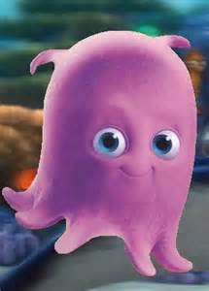
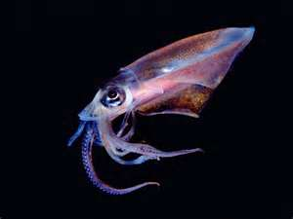
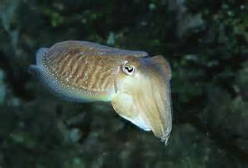
Class Cephalopods
Most advanced nervous system.
Fast moving predators
Beak-like jaw
Closed circulatory system-blood is pumped by a heart through vessels, and does not normally fill body cavities.
Circle of tentacles attached from head.
EX: Octopus, squid, cuttlefish

Slide 7
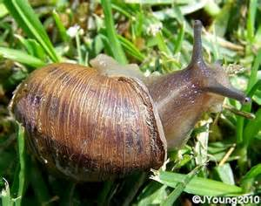
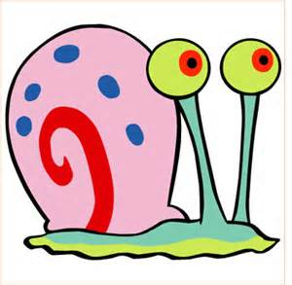
Class Gastropods
The largest class of mollusks
Single or no shells
Wavelike contractions on bottom of Gastropods allow them to move.
Has an Open Circulatory system- circulatory fluid is collected through gills or lungs and pumped through heart and released into space in tissues.
EX: snail

Slide 8
Wrap- Up
Write something you learned about mollusks.

