Slide 1
Arthropods
By:Chipper Brockman, Andy Hwang, Di'en Jenkins, and Maddie Wade

Slide 2
Arachnids
A class of jointed-leg invertebrate animals in the subphylum Chelicerata. All arachnids have 8 legs

Slide 3
Drill
What is an Arthropod?

Slide 4
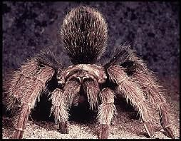
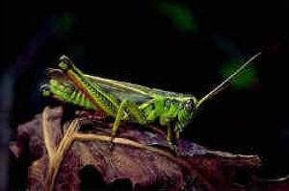
Arthropods are insects, crabs, centipedes, or spiders that have a segmented body, a tough exoskeleton, and appendages.

Slide 5
Vocab
Appendages- structures such as a leg, or antenna,that extends from the body of the wall
Chelicerates-special mouthparts called checlirae in two body sections used to stab and paralyze prey

Slide 6
Vocab cont.
Chitin- complex carbohydrate that makes up the cell walls of fungi; also found in the external skeleton in arthropods
Crustaceans-primarily aquatic that includes organisms such as crabs, shrimp, lobster, crayfish, barnacles; range in size from small terrestrial pill bugs to spider crabs; typically have two pairs of branched antenna, two or three body sections, and mouthparts called mandibles

Slide 7
Vocab cont.
Exoskeleton- external skeleton; tough external covering that protects and supports the body of many invertebrates
Molting- process in which an Arthropod sheds its exoskeleton and manufactures a larger one to take its place

Slide 8
Vocab cont.
Spiracles- small opening located along the side of the body through which air enters and leaves the body of many terrestrial Arthropods
Uniramians- Centipedes, millipedes, and insects; have jaw, one pair of antenna, and unbranched appendages

Slide 9
General Characteristics
Arthropods are segmented animals
They also have appendages, which are jointed extensions from the body
Exoskeleton is made out of three layers
Have compound eyes (eyes composed of many light detectors and they each have their own lens)

Slide 10
3 Major Groups
Crustacea:
Crustacea includes shrimps, lobsters, crabs, crayfish, barnacles, isopods, and copepods. Members of this subphylum, known as crustaceans, have branched antennae and a pair of chewing mouthparts called mandibles.

Slide 11
Chelicerata:
Chelicerata includes spiders, scorpions, mites, ticks, sea spiders, and horseshoe crabs. This group is distinguished from other groups by the absence of antennae and the presence of pincerlike mouthparts called chelicerae.

Slide 12
Uniramia:
Uniramia includes centipedes, millipedes, and insects. Members from this group have their appendages unbranched. They are the only group to have evolved on land.

Slide 13
A class of jointed-le

Slide 14
More Info
Arthropods use gills to breathe
Use teeth to grind down food to eat
The abdomen and cephalothorax are the two main sections of the arthropods

Slide 15
Activity

Slide 16
Exam Question
What are chelicerates?
a) The antenna of an arthropod
b) External Skeleton
c) Small opening on the side in which air enters and leaves
d) Special mouthparts used to stab and paralyze prey

Slide 17
Wrap Up
Define Molting.

